Slide 1


FAKE NEWS DETECTION
P R DHIVYA
2021503305

Slide 2
AGENDA
PROBLEM STATEMENT
OBJECTIVE
PROPOSED SYSTEM

Slide 3
PROBLEM STATEMENT
The proliferation of misinformation and fake news on social media platforms and news websites has become a significant societal concern.
In an age where information spreads rapidly, distinguishing between genuine news and fabricated stories is increasingly challenging.
This project aims to address this issue by developing a robust classification system to automatically identify fake news articles.

Slide 4
OBJECTIVE
The objective of this project is to develop a sophisticated and robust fake news classification system capable of effectively identifying and distinguishing between genuine and fabricated news articles.
The aim is to create a model that can autonomously analyze textual content to accurately classify news articles as either authentic or deceptive.
To develop an efficient and accurate fake news classification system that can automatically distinguish between genuine and fabricated news articles with a high degree of reliability.

Slide 5
PROPOSED SYSTEM
Gather a diverse dataset of news articles from various sources, including both legitimate and questionable sources.
Preprocess the data to remove noise, perform tokenization.
Extract relevant features from the preprocessed text, including Bag-of-Words representations.
TF-IDF (Term Frequency-Inverse Document Frequency) vectors.
Explore a variety of machine learning algorithms using Naive Bayes.
Train the selected models on the feature-rich dataset using appropriate training/validation splits and cross-validation techniques.

Slide 6
PROPOSED SYSTEM
Evaluate the performance of the trained models using standard metrics such as accuracy, precision, recall, and F1-score.
Integrate the trained model into a user-friendly interface, allowing users to submit news articles for classification.
Implement mechanisms for continuous monitoring and updating of the model to adapt to evolving patterns of misinformation.
Incorporate a feedback loop where users can report misclassified articles, providing valuable data for model refinement and improvement over time.
Accompany the classification system with educational resources to promote media literacy and critical thinking skills among users.

Slide 7
SYSTEM APPROACH
In this approach are:
System Overview.
Processing Pipeline.
Output and Applications.
SYSTEM OVERVIEW
The fake news classification system is designed to automatically identify and categorize news articles as either genuine or fake based on their content and linguistic features.

Slide 8
SYSTEM APPROACH
PROCESSING PIPELINE:
Preprocessing
Feature extraction
Model training
OUTPUT AND APPLICATIONS:
Once trained and validated, the fake news classification system can be deployed for real-time classification of news articles.

Slide 9
ALGORITHM AND DEPLOYMENT:
Deep Neural Networks (DNN):
DNNs, particularly deep learning models like recurrent neural networks (RNNs) or convolutional neural networks (CNNs), can capture intricate patterns and relationships in textual data.
They can automatically learn feature representations from raw text, potentially uncovering nuanced linguistic cues indicative of fake news.
NAIVE BAYES:
Naive Bayes is a simple and efficient probabilistic classifier based on Bayes' theorem with strong assumptions of feature independence.

Slide 10
ALGORITHM AND DEPLOYMENT:
It is computationally lightweight and can handle high-dimensional data efficiently, making it suitable for text classification tasks with limited computational resources.
MODEL SERIALIZATION:
Serialize the trained model into a format that can be saved and loaded efficiently, such as a pickle file for traditional machine learning models or a TensorFlow Saved Model for deep learning models.
SCALABILITY AND PERFORMANCE OPTIMIZATION:
Ensure that the deployed model can handle multiple concurrent requests efficiently. This may involve deploying the model on scalable infrastructure such as Kubernetes or using cloud-based services like AWS Lambda.

Slide 11
ALGORITHM AND DEPLOYMENT:
MONITORING AND MAINTENANCE:
Monitor the performance of the deployed model over time and implement mechanisms for retraining the model periodically with new data to maintain its accuracy. Additionally, address any issues or bugs that arise in the deployed system.
USER INTERFACE (OPTIONAL):
Develop a user interface (UI) if the deployment involves a standalone application or web service. The UI can allow users to interact with the model, submit input data, and view classification results.
DOCUMENTATION AND SUPPORT:
Provide comprehensive documentation and support resources for users who want to integrate the fake news classification system into their applications or workflows.

Slide 12
IMPLEMENTATION
DATA COLLECTION AND PREPROCESSING:
Gather a dataset of labeled news articles, with labels indicating whether each article is real or fake.
Preprocess the text data by tokenizing the articles, removing stop words, and applying other text normalization techniques.
FEATURE EXTRACTION:
Extract relevant features from the preprocessed text data. For DNN, this may involve converting the text into word embeddings using techniques like Word2Vec or GloVe. For Naive Bayes, feature extraction typically involves creating a bag-of-words or TF-IDF representation of the text.

Slide 13
IMPLEMENTATION
MODEL TRAINING:
Train separate DNN and Naive Bayes models on the labeled dataset.
For DNN, design a neural network architecture suitable for text classification tasks, incorporating layers such as embedding layers, recurrent layers (e.g., LSTM or GRU), and dense layers. Train the model using backpropagation and optimization algorithms like Adam.
MODEL EVALUATION:
Evaluate the trained models using appropriate evaluation metrics such as accuracy, precision, recall, and F1-score on a separate test dataset. This step helps assess the performance of each model in distinguishing between real and fake news.

Slide 14
IMPLEMENTATION
DEPLOYMENT:
Deploy the trained models as RESTful APIs or web services to enable real-time inference.
Set up server infrastructure using frameworks like TensorFlow Serving for DNN models or Flask for Naive Bayes models.
MONITORING AND MAINTENANCE:
Monitor the deployed models for performance metrics, such as response time and accuracy, to ensure reliability.
Implement versioning and rollback mechanisms to manage model updates and potential issues.

Slide 15
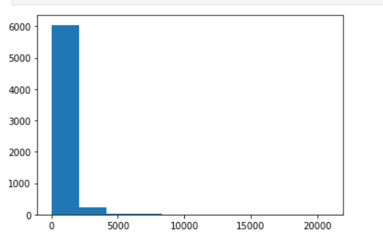
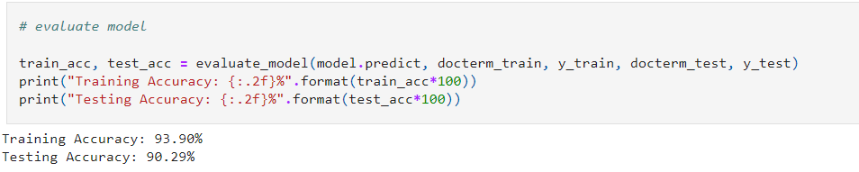
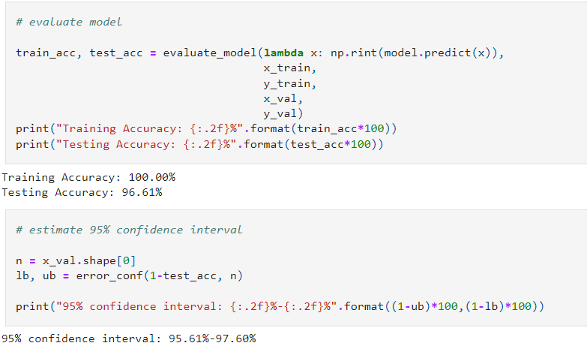
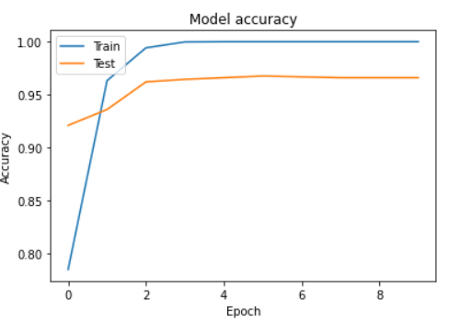
RESULT

Slide 16
CONCLUSION
The conclusion of a fake news detection system using Deep Neural Networks and Naive Bayes algorithms offers a robust approach to combating misinformation in news articles. Through data preprocessing, model training, and deployment as RESTful APIs, users can quickly identify fake news with high accuracy. Continuous monitoring ensures ongoing reliability, contributing to media literacy and fostering an informed society.

Slide 17
THANK YOU

